Slide 1
Hello world!

Slide 2
Outline
In this presentation, we will:
  Describe programs
  Define programming languages
  Our first program: Hello world!
  Integrated development environments and on-line compilers
  The steps of compiling a program

Slide 3
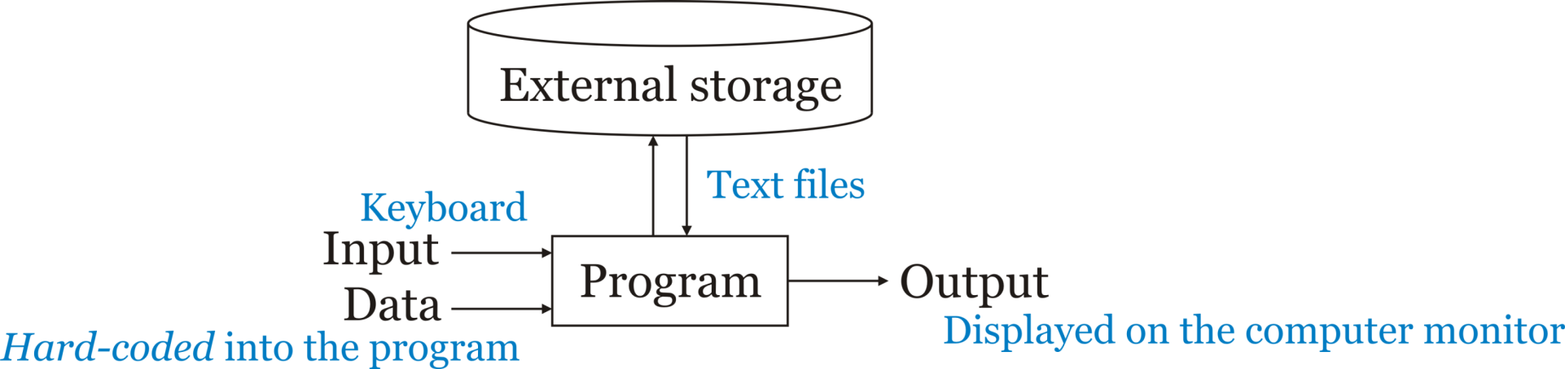
What is a program?
In this course, our programs will have inputs and outputs
  Inputs are hard-coded, entered using a keyboard or read from a file
  Output is displayed on the screen

Slide 4
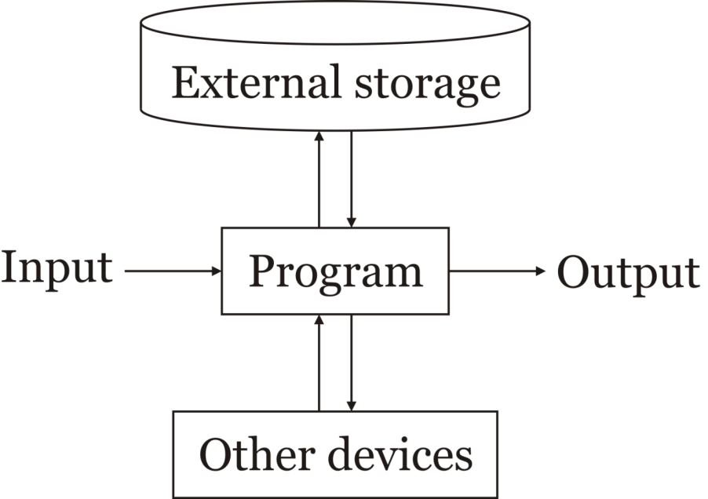
What is a program?
Hard-disk drives
Solid-state drives
Floppy drives
Optical drives
Tape drives
The Cloud
In general, a program:
  Receives input
  Communicates with other devices
  Reads and stores data in external storage
  Produces output
Note: these definitions are fluid
  Printers and keyboards may
  communicate with the program
  Any external storage is technically a device
    Their dedication to long-term storage of data
Keyboards
Mouse
Microphone
Image scanner
Camera
Sensors
Monitors
Printers
Speakers
Actuators
Through:
- Expansion bus
- Internet
- Bluetooth
- CAN bus

Slide 5
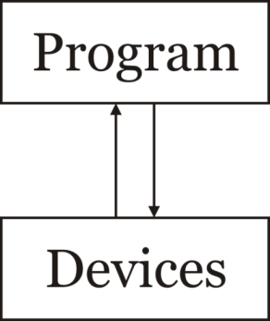
What is a program?
A simplified model:
  A program communicates with devices to retrieve, process and store data
It’s still useful to consider the primary use of a device, be it for:
  Input
  Output
  Storage
or a device to be communicated with

Slide 6
Why learn to program?
Why learn programming?
  Programming is a systematic means of giving instructions to perform a task
  If you are in electrical engineering, we have authored a web site to try to help you understand why the material in this course is relevant:
  Why learn programming for electrical-engineering students?

Slide 7
Executing programs
When you execute/open/run an application, your computer, laptop or smart phone begins executing instructions
  These instructions are coded using a binary encoding: 0s and 1s
  The set of all possible instructions defines a machine language
  These are difficult to read:
    01100100 0011 0110 0101001000101010
    01001110 0101 0011 0011100010001011
    10001101 1010 0110 0000000000000000

Slide 8
Programming languages
A programming language is a human readable means of specifying the operations a computer is to perform
Programming languages are used to generate source code
  This source code is compiled and translated into machine instructions
  The resulting instructions can then be executed
Programming languages are restricted, however, to the characters that appear on a standard keyboard

Slide 9
Programming languages
All of programming falls under the domain of mathematics
  The Cheriton School of Computer Science is within the Faculty of Math
We cannot use mathematical notation in programming languages, and thus we must use other means of describing our intentions
Expression | Representation in C++
2(x + y) | 2*(x + y)
 | (n*n*n)/3
 | 0.5*9.8*s*s + v0*s
sin(x) | sin(x)
|x| | abs(x)
 | sqrt(x)

Slide 10
Our first program
#include <iostream>
int main();
int main() {
std::cout << "Hello world!";
std::cout << std::endl;
return 0;
}

Slide 11
Our first program
There are two approaches we can take to compiling and executing this code:
  Using an Integrated Development Environment (ide)
    We will use VS Code in the laboratories
  Using an on-line compiler such as https://replit.com/
On-line compilers, however:
  May not always be available
  Are sub-optimal for larger projects

Slide 12
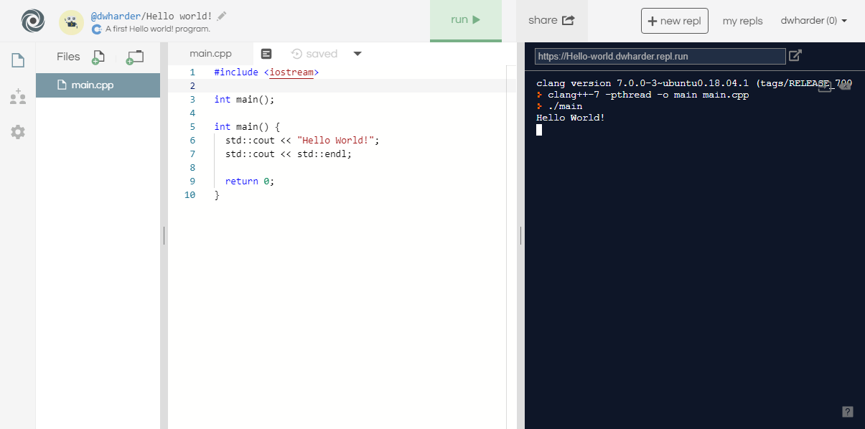
Our first program

Slide 13
Our first program
When you select the Run button, text is printed to the console output
  Question: What is happening behind the scene?

Slide 14
Steps in generating an executable program
The program undergoes the following four steps in order to create an executable program that you can run
  Step 1: Creating the program using a programming language, and writing it using an editor
  Step 2: Compiling the program into machine-language code
  Step 3: Linking together the program with other helper programs into a single executable program
    E.g., printing to the screen
  Step 4: Executing the program
Program Code
Compiler
Linker
Executable program

Slide 15
Summary
In this presentation, you now
  Understand what a program is
  Have an overview of how computers executing instructions
    These are encoded in binary: 0s and 1s
  Understand that programming languages allow us to define programs using a human-readable interface
    The program must be compiled into an executable and run
  Have written your first program: the ubiquitous Hello world!
  Saw this output on https://replit.com
    The first lab includes installing the VS Code ide
    You are not required to use VS Code,
    but it is the only ide that is supported
  Understand the steps of compilation

Slide 16
References
[1] https://en.wikipedia.org/wiki/APL_(programming_language)

Slide 17
Acknowledgments
Proof read by Dr. Thomas McConkey

Slide 18



Colophon
These slides were prepared using the Georgia typeface. Mathematical equations use Times New Roman, and source code is presented using Consolas.
The photographs of lilacs in bloom appearing on the title slide and accenting the top of each other slide were taken at the Royal Botanical Gardens on May 27, 2018 by Douglas Wilhelm Harder. Please see
https://www.rbg.ca/
for more information.

Slide 19
Disclaimer
These slides are provided for the ece 150 Fundamentals of Programming course taught at the University of Waterloo. The material in it reflects the authors’ best judgment in light of the information available to them at the time of preparation. Any reliance on these course slides by any party for any other purpose are the responsibility of such parties. The authors accept no responsibility for damages, if any, suffered by any party as a result of decisions made or actions based on these course slides for any other purpose than that for which it was intended.

